Slide 1
Advertisement Or Not
By:
Suram Saihith Reddy

Slide 2
Advertisement or not
Aim is to predict wheather the content is based on advertisement or not.
Train data set consist of 1157 rows and 5 columns.
Test data set consist of 799 rows and 5 columns.

Slide 3
Section A
About Independent variables.
About Target variables.
Data preprocessing.
Text data to binary form.
Checking the model performance.
Results (roc_auc_curve).
Most significatent variables.

Slide 4
About Independent variables
Initailly, 4 have independent variables.
Comment_id,Author,Date and Content.
Comment_id,Author,Date are not important variable to predict wheather content is advertisement or not
Now,I need to proceed with content variable only.

Slide 5
About Target variables
Target variable as two class.
1 - Advertisement, 0 - not Advertisement
class 1 has 586 rows and class 0 consists of 571 in train data set.
Balanced data.

Slide 6
Data Preprocessing
Checking of null values in the data.
Text Pre-processing:
Changing the text to lower case.
Strip:Unwanted spaces.
Lemmatization.

Slide 7
Text data to Binary form
Changing the text data to document term matrix with the help of count vectorizer.
With the help count vectorizer, we can remove stop words, words in token pattern and ngram_range.
Thus, we get a matrix of 1157 rows and 9590 columns

Slide 8
Checking the model performance
I split the train data set into train of 70% and test of 30%.
After spliting the data, Tried to build the models with the help of different algorithms.
Which ever model is giving the good roc_auc score.I tried to build the model with entire train data set.

Slide 9
Results
Losgistic Regression, Random Forest, Decision tree, Gradient bossting algorithms are giving pretty much score.
My model performance increased when I put above models into stacking and voting classifier.

Slide 10
Most Significatent variable
Top five important varaible are:
Check
Subscribe
Channel
Com
Youtube

Slide 11
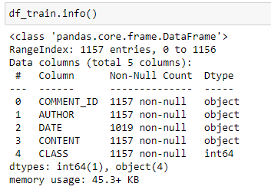
Section B
Train data set info

